Slide 1

Spam Email Prediction System: End-to-End Process
This presentation will walk you through the steps of building a spam email detection system from raw email data to a trained model that can classify spam emails.
By
Avanti Nipunge
Myna Nereti
Pratikshay Awadhoot

Slide 2
Introduction
This presentation demonstrates the entire pipeline for spam email detection. It starts by exploring the initial data collection methods, followed by preprocessing techniques that ensure data cleanliness and relevancy. Next, it delves into feature extraction, where key characteristics of spam emails are identified. The pipeline then incorporates advanced machine learning models trained to classify emails as spam or non-spam
It covers:
Raw data analyzation
Feature Extraction
Preprocessing (Cleaned mail)
Text Vectorization
Model Training and Evaluation

Slide 3
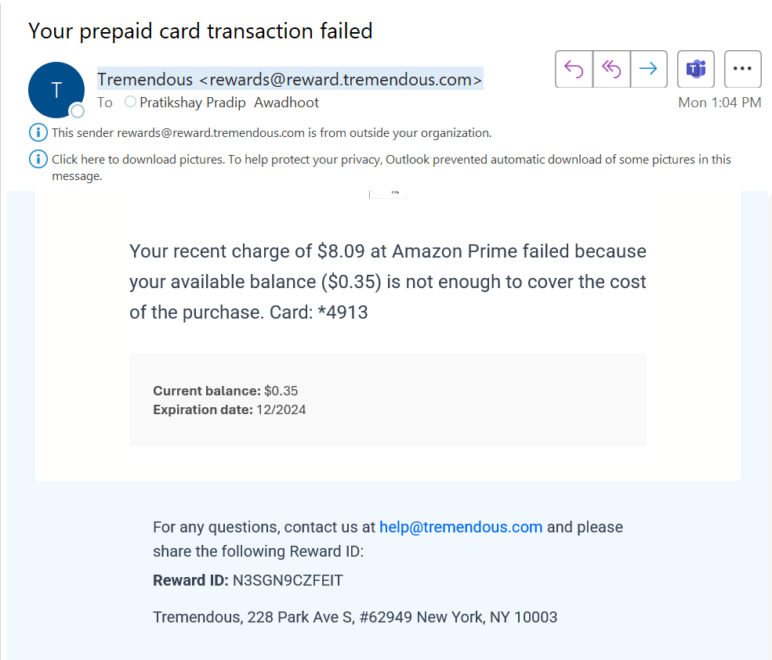

SPAM Email Data Example

Slide 4
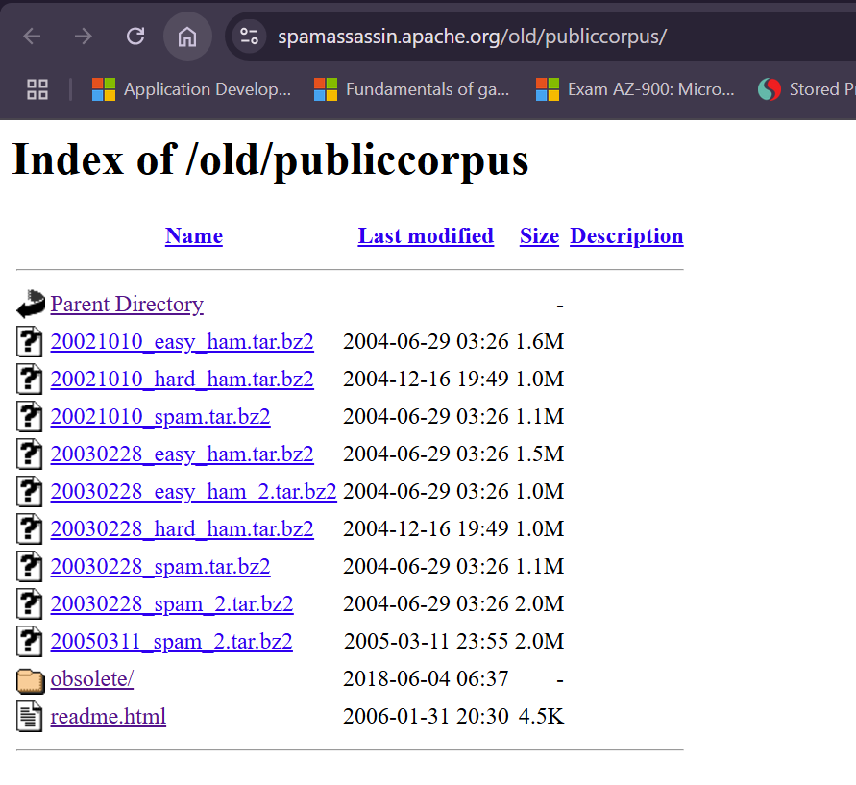

Dataset used size of the data
Credits to https://spamassassin.apache.org/old/publiccorpus/

Slide 5

Raw Email Data Analyzing
1 Header:
From: amknight@mailexcite.com
The sender's email address, which indicates the origin of the email.
To: cbmark@cbmark.com
The recipient's email address, specifying the intended receiver.
Subject: New Improved Fat Burners, Now With TV Fat Absorbers!
The subject line provides a summary of the email content, often used to grab attention.
2 Body:
The body contains the main message, divided into several elements:
Promotional Statement:
"*****LOSE 30 POUNDS IN 30 DAYS... GUARANTEED!!!*****“
Highlighted in uppercase and with asterisks to emphasize the promise of quick weight loss, typical of spam content.
Product Information:
"All Natural Weight-Loss Program:“
Details about the product's features:
"Speeds up metabolism safely“
"Rated #1 in safety & effectiveness“
"No banned substances, no side effects"
3 Offer:
"BONUS OFFER: Receive a free supply with purchase of 2 bottles."
Includes a call-to-action, incentivizing purchase by offering additional products for free.
4 Call-to-Action:
"Order Now! Limited Time Offer!“
Urges immediate action from the recipient, creating a sense of urgency.
From: amknight@mailexcite.com
To: cbmark@cbmark.com
Subject: New Improved Fat Burners, Now With TV Fat Absorbers!
*****LOSE 30 POUNDS IN 30 DAYS... GUARANTEED!!!*****
All Natural Weight-Loss Program:
- Speeds up metabolism safely
- Rated #1 in safety & effectiveness
- No banned substances, no side effects
BONUS OFFER: Receive a free supply with purchase of 2 bottles.
Order Now! Limited Time Offer!

Slide 6
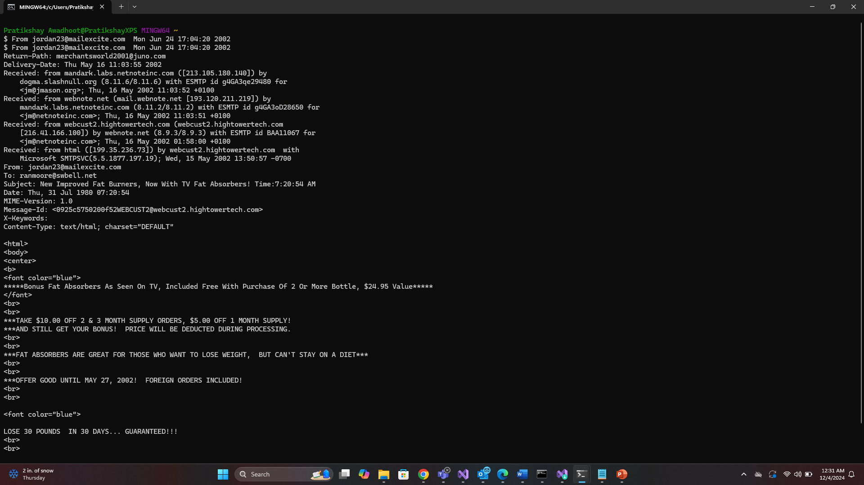
Actual Raw Email Data
Raw emails are provided in individual files, each containing:
Sender, Receiver, Subject, body, message id
HTML content, CSS features for UI
Metadata (e.g., MIME format)

Slide 7

Feature Extraction
Sender
Receiver
Body
Mail
Sender
Receiver
Subject
Body

Slide 8

Feature Extraction
Sender
Receiver
Body
Mail
Sender
Receiver
Subject
Body

Slide 9

Feature Extraction
Sender
Receiver
Body
Mail
Sender
Receiver
Subject
Body

Slide 10

Feature Extraction
Sender
Receiver
Body
Mail
Sender
Receiver
Subject
Body

Slide 11

Feature Extraction
Sender
Receiver
Body
Mail
Sender
Receiver
Subject
Body

Slide 12
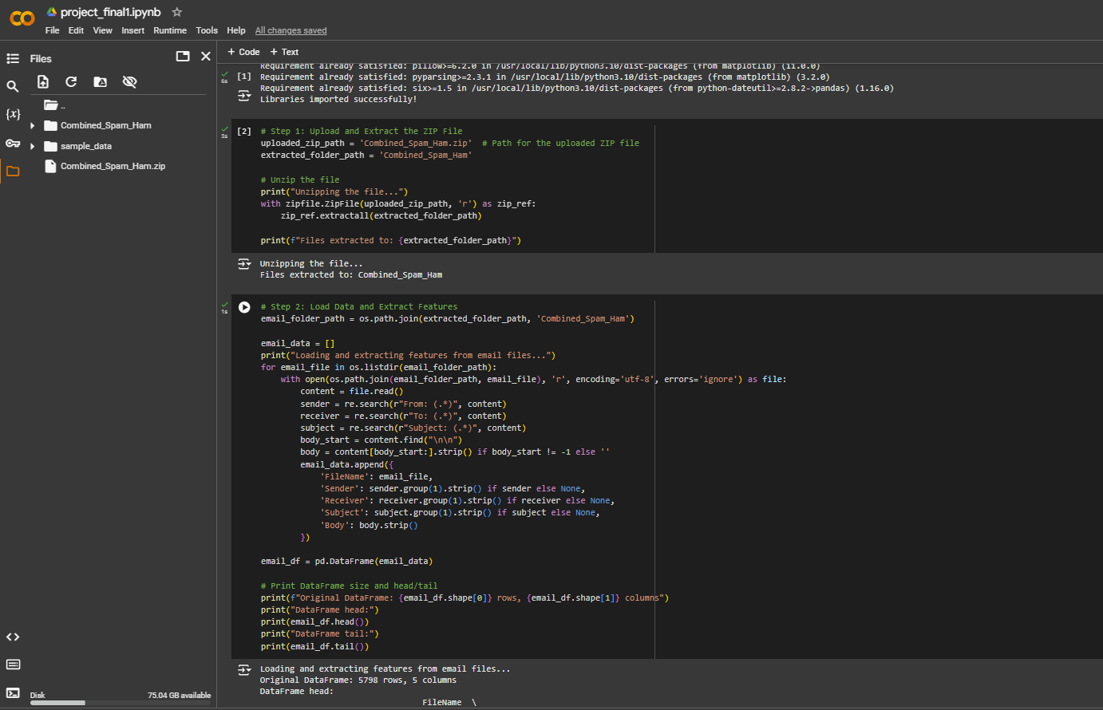
Results

Slide 13
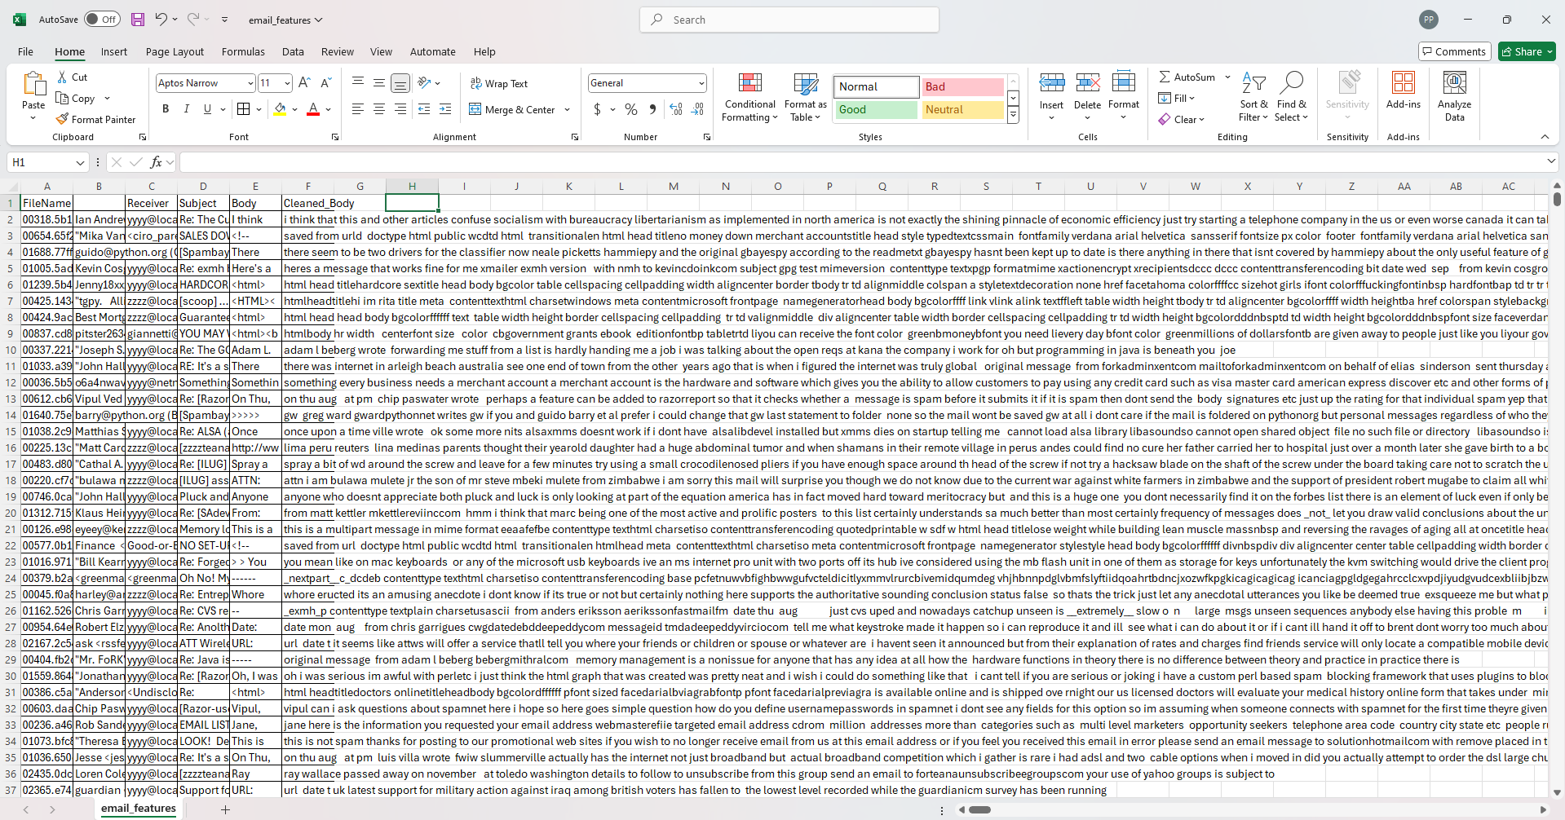
Results In CSV

Slide 14
Preprocessing
Cleaning Steps
Remove Extra Spaces
Remove URLs:
Remove Numbers:
Remove Punctuation:
Convert to Lowercase:
Benefits of Preprocessing
Noise Reduction:
Standardization:
Feature Enhancement:

Slide 15
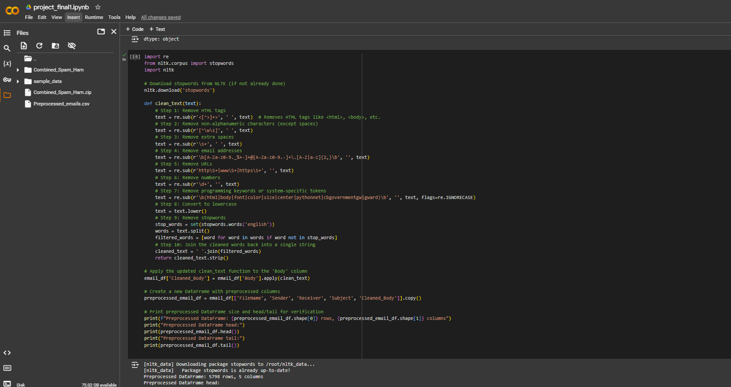
Preprocessing

Slide 16
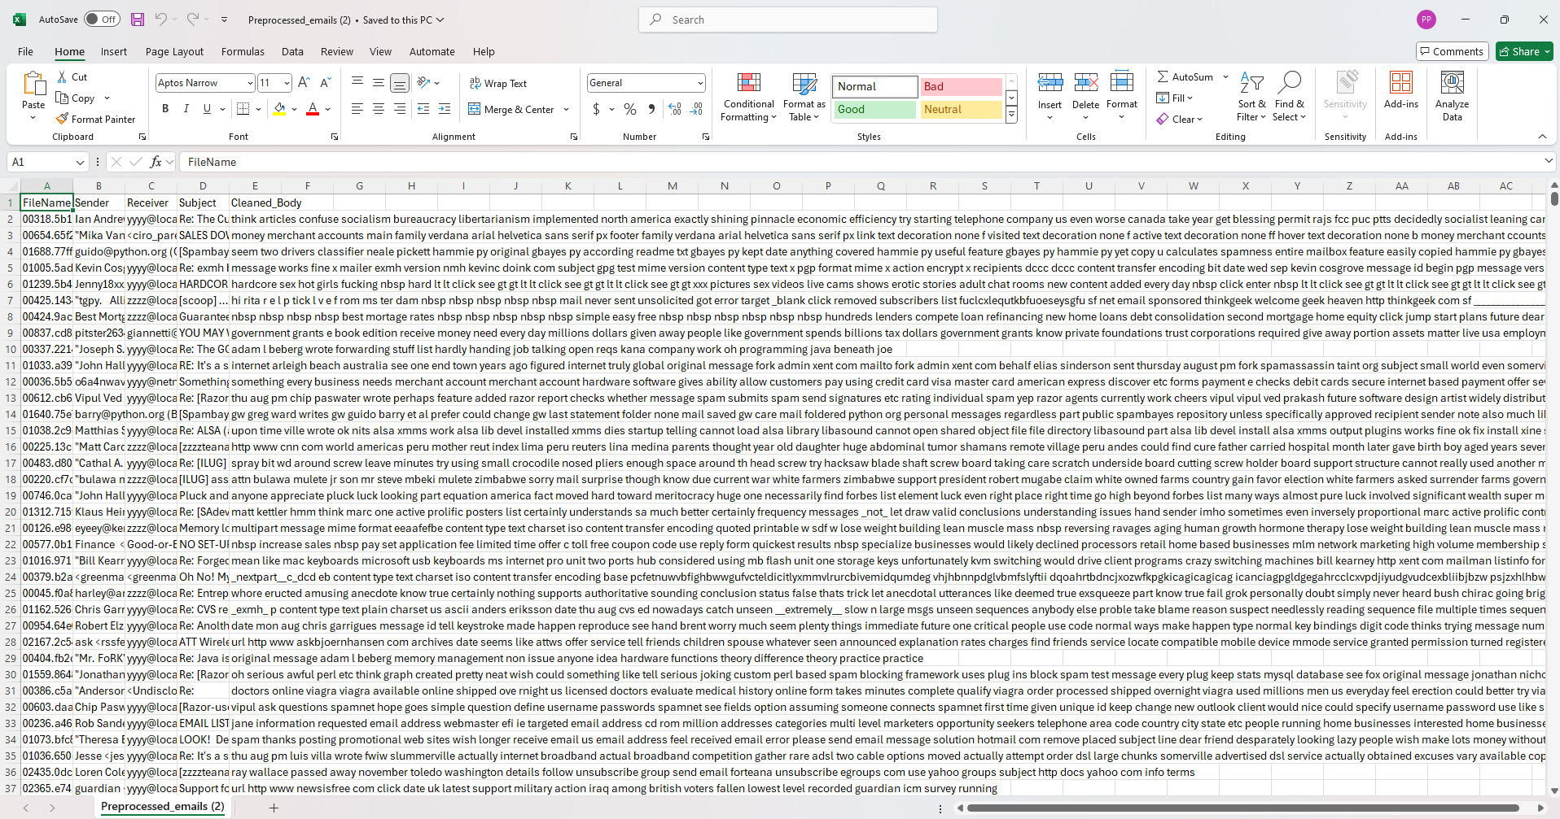
Preprocessing

Slide 17
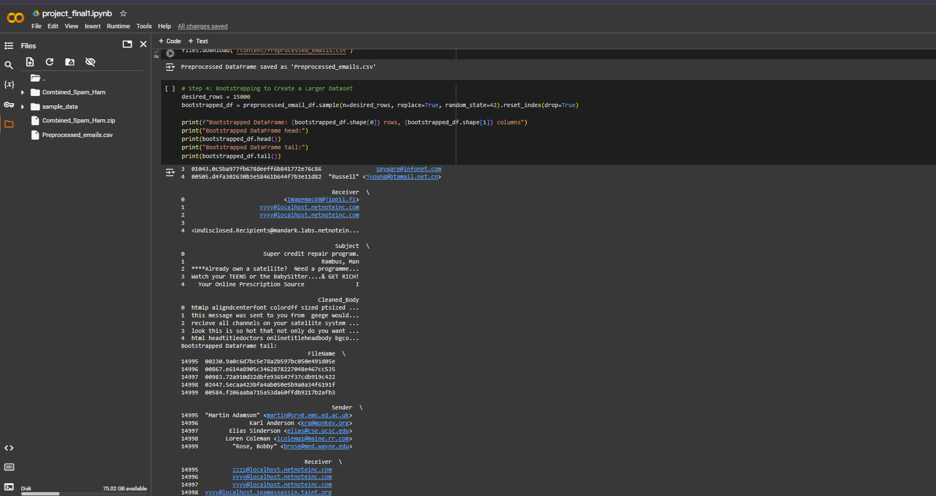
Generating More Data Bootstrapping Method

Slide 18

Data Training & Class Label
Raw Email

Slide 19

Data Training & Class Label
Raw Email
Data Preprocessing

Slide 20

Data Training & Class Label
Spam Indicators
Raw Email
Data Preprocessing

Slide 21

Data Training & Class Label
Spam Indicators
Raw Email
Vectorization
Data Preprocessing

Slide 22

Data Training & Class Label
Spam Indicators
Raw Email
Word2Vec or BERT
Vectorization
Data Preprocessing

Slide 23

Data Training & Class Label
Spam Indicators
Raw Email
Vectorization
Data Preprocessing
Classifiers

Slide 24
Data Training & Class Label
Spam Indicators
Raw Email
Vectorization
Data Preprocessing
Classifiers
Predict

Slide 25
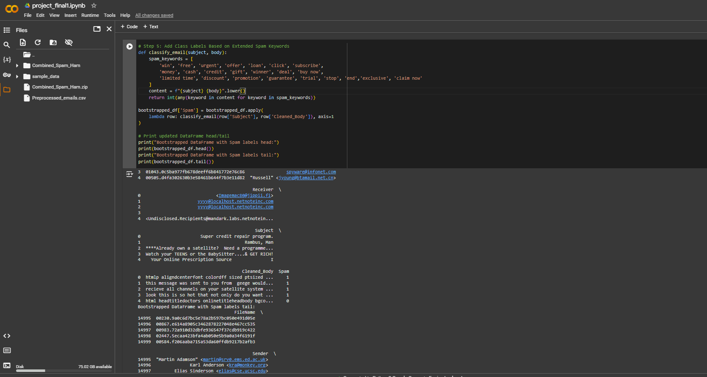
Spam Indicators and generating Class label

Slide 26
Word Embedding using word2vec
Why Word2Vec Was Chosen:
Semantic Understanding:
Word2Vec generates vector representations that capture the semantic meaning of words. For instance, "offer" and "deal" will have similar vector representations because they often appear in similar contexts. This semantic clustering helps the model identify spam-related patterns that keyword-based or one-hot encoding methods might miss.
Dimensionality Reduction:
Unlike methods like one-hot encoding or bag-of-words, which create very high-dimensional vectors (corresponding to the vocabulary size), Word2Vec reduces each word to a fixed-size vector. This makes it computationally efficient and avoids the curse of dimensionality.
Flexibility and Pretraining:
Word2Vec models can be pretrained on larger datasets (if needed) and then fine-tuned or used directly on your specific dataset. This pretraining can help capture general language nuances that are useful even in smaller datasets.
Context Awareness:
Word2Vec's skip-gram and CBOW algorithms focus on capturing the context of words, which is beneficial for understanding phrases or common spam-related expressions in your dataset.

Slide 27
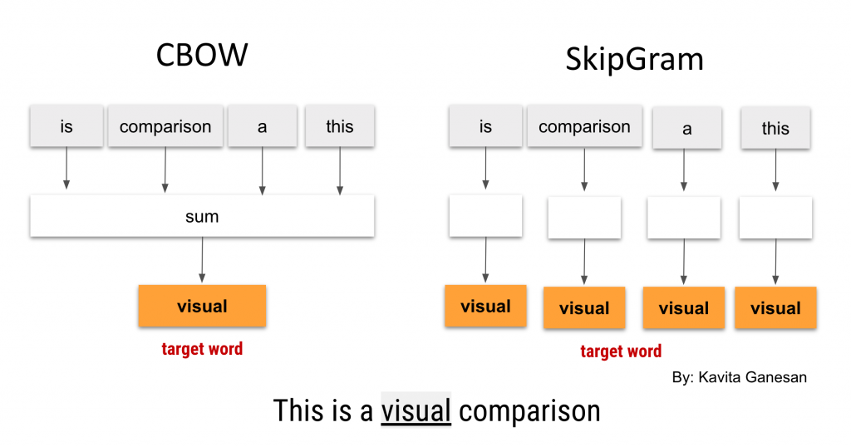
Word Embedding using word2vec

Slide 28
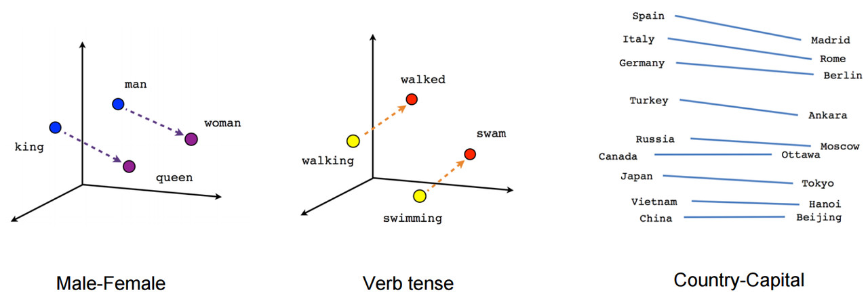
Word Embedding using word2vec

Slide 29
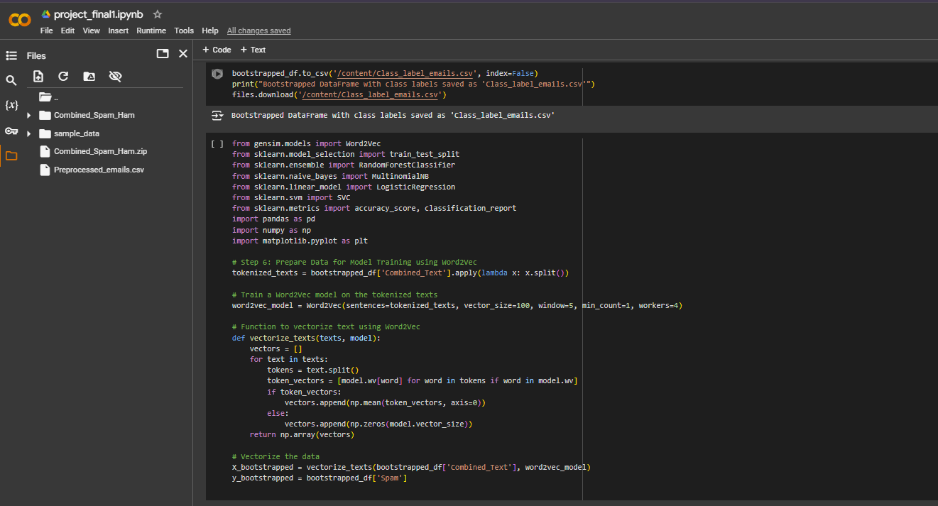
Word Embedding using word2vec

Slide 30
Train and Evaluate Models
Feature | Logistic Regression | SVM
Purpose | Linear decision boundary | Works well for linear and non-linear boundaries (with kernels)
Speed | Fast to train | Slower, especially for large datasets
Complexity | Simpler, interpretable | More complex, harder to interpret
Scalability | Scales better to large datasets | Slower with large datasets
Non-linear Problems | Struggles without transformations | Handles non-linear problems (with kernels)

Slide 31
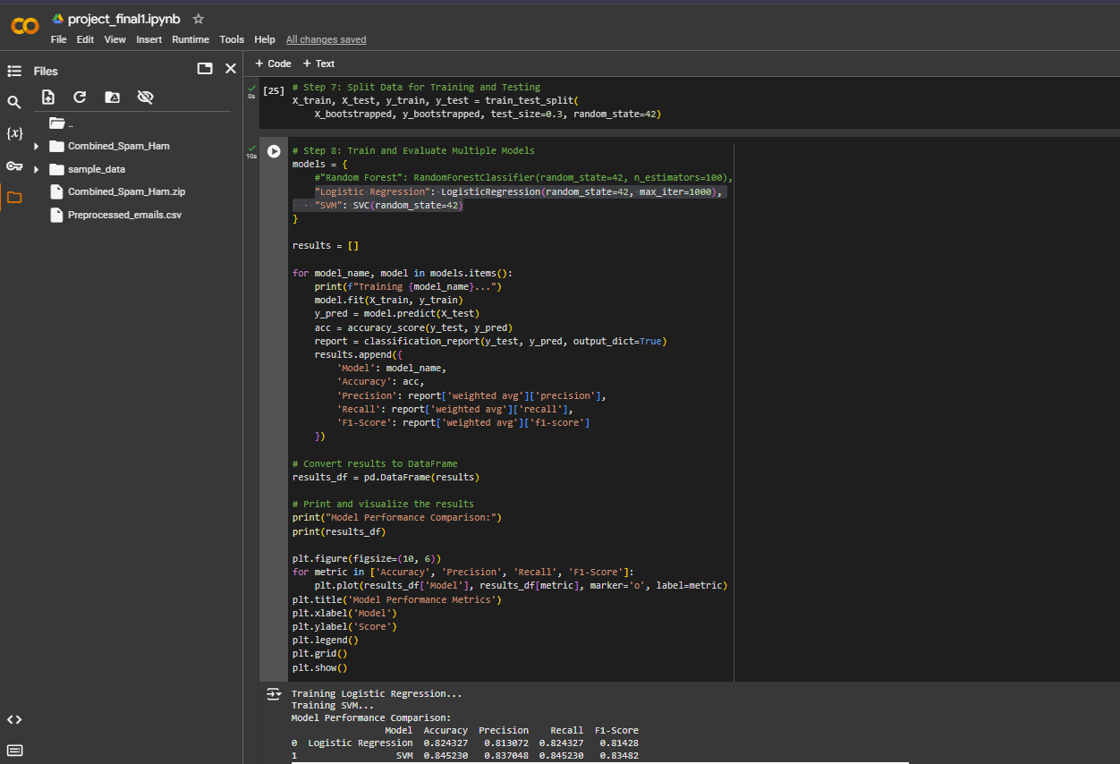
Train and Evaluate Models

Slide 32
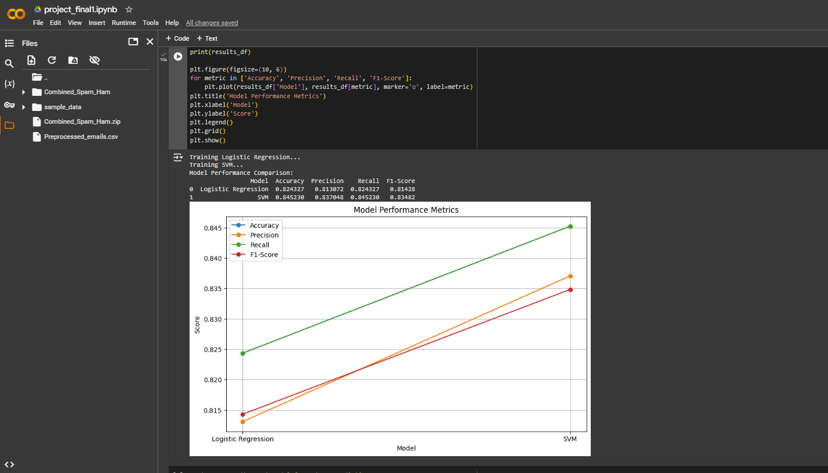
Classification report

Slide 33
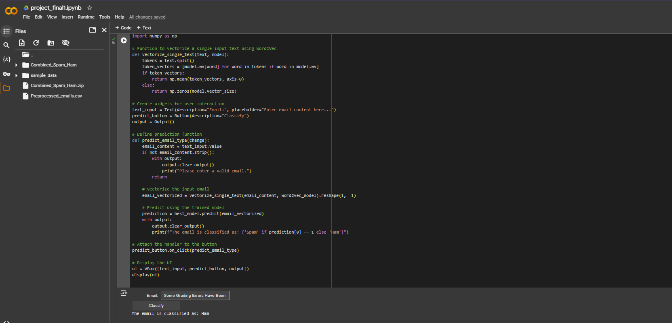
Final Prediction Using Best model
Email Body: Some Grading Errors Have Been Found in Short Exam 2. They all have been corrected now. Some of scores of the Short Exam2 have been updated (mostly lowered) now

Slide 34
summary
1. Extract raw emails from the dataset.
2. Preprocess data to clean and tokenize text.
3. Extract features such as length, keywords, and sender.
4. Vectorize text using TF-IDF.
5. Train and evaluate a classifier.
6. Use the model for spam prediction on new emails.

Slide 35
Future Scope
Real-Time Detection Systems
Build a real-time detection pipeline that can:
Detect spam while the email is being delivered.
Provide immediate classification feedback to users.
Develop lightweight, low-latency models optimized for real-time systems.
Personalized Spam Filtering
Create customized spam detection models tailored to individual users
based on their email habits, preferences, and history.
Utilize user-specific thresholds for spam classification to reduce false positives.
Adversarial Email Handling
Develop methods to counteract adversarial attacks where spammers attempt to
evade detection by Introducing noise in emails. Using obfuscation techniques like replacing
letters with symbols or numbers.

